Slide 1
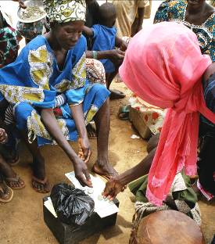

Saving for Change
Community Managed Micro Finance

Slide 2
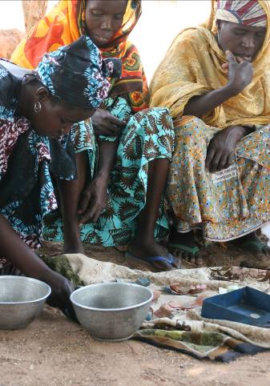
Saving for change is a new model of microfinance for those left out
A New Model for Microfinance
Vast scale
Low cost
Builds on local capacity/knowledge
Delivery by local partners
Groups train new groups
Resilient
No external fund

Slide 3
Collaborators
Freedom from Hunger
  Co-development of training manuals
  Training of animators and trainers
  Malaria curriculum
Stromme Foundation
  Funding the partner costs in Mali and Burkina Faso

Slide 4
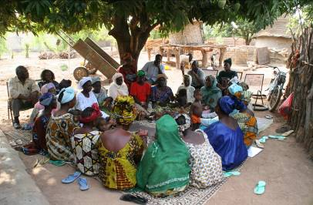
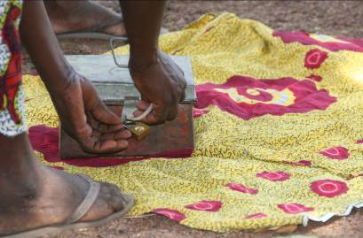
Why is Saving for Change Needed?
A safe place to save
A flexible, available source of small loans
Someone to turn to in case of need
Encouragement and support
A chance for women to have influence

Slide 5
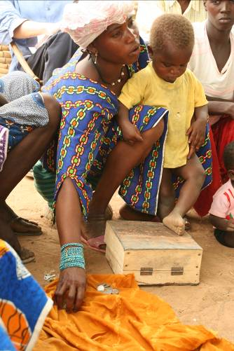
Saving for Change Overview
371,770 members in 5 countries in 50 months
million + dollars in savings
Mali : 263,705
Cambodia : 66,162
Senegal : 32,564
Burkina Faso : 4,000
El Salvador : 5,339

Slide 6
Process
Feasibility Study
Presentation of program to potential partners
Applicants submit proposals
Evaluate proposals and partners
Fund selected proposals
Recruitment of animators and supervisor
Training animators and supervisor
Program Implementation begins
Ongoing Monitoring and Supervision
Expansion and Scale up

Slide 7
Process
Oxfam
Funds
Training
Local Partners
Training
Groups of Savers

Slide 8
Training Regimen
Initial training period lasts 1-3 months
8 training sessions for facilitating the group rules
Participatory curriculum for rules generation
Simple system for running meetings
Malaria prevention curriculum starts after group has internalized savings and lending
Group graduates after roughly one year

Slide 9
Training Topics
Prepare the group
Organise the group
Set internal regulations
Attendance and savings goals
Keeping oral records and starting to save
Fund utilisation and loan appraisal
Setting loan policies
Lending
Distribution

Slide 10
Save
$

Slide 11
Borrow
$

Slide 12
Save and Repay
$
+
$

Slide 13
Group Leaders Create New Groups
Group 1
Group 2
$
+
$
$

Slide 14
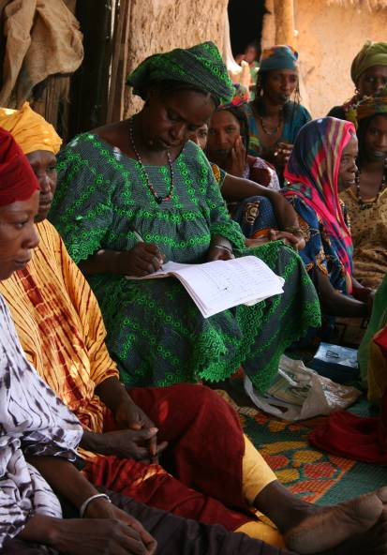

Slide 15
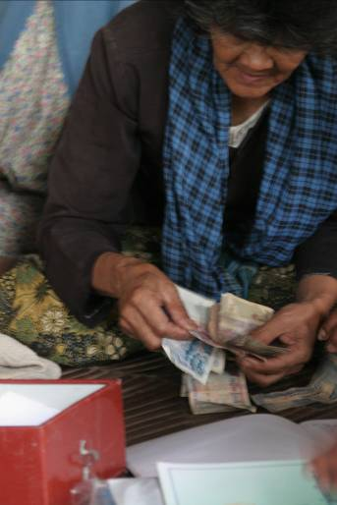
Why SfC Works
“Modernizes” traditional savings groups:
Bylaws and officers
Better records
Goals
More saving
Greater flexibility
“Virtual insurance”

Slide 16
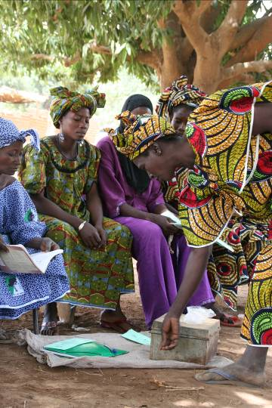
Why SfC Works (Continued)
Adapted to regions with very low literacy
Platform for additional training and education
Groups make all decisions

Slide 17
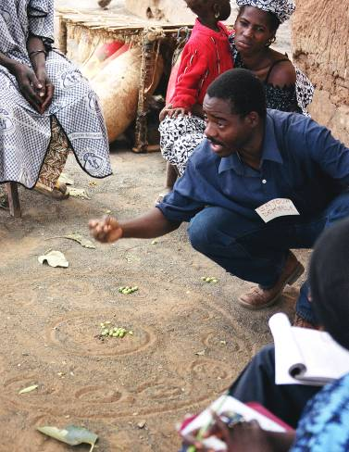
Based on good business practices
Standardization
Low cost/local control
Careful partner selection/ training
Close monitoring and supervision
Comprehensive documentation

Slide 18
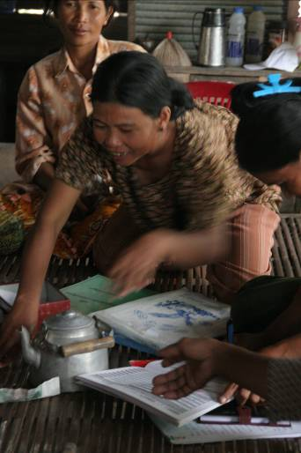
Findings
The poor save but lose
20% every year
With SfC they earn
20% - 40% every year
Enough $ in village for
most needs
Groups can manage fund even if members are illiterate
Excellent repayment

Slide 19
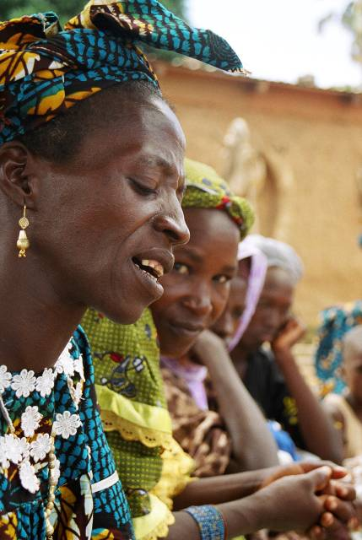
Mali
Poverty ranking: 175 of 177 countries
Poverty incidence: 64%
Rampant malaria
Prone to drought
90% members illiterate
50% had enough to eat
*Sources: UNDP HDI, 2006 and BEGIP, 2007

Slide 20
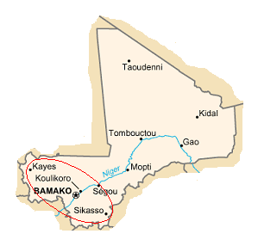
Mali Expansion
Current Area

Slide 21
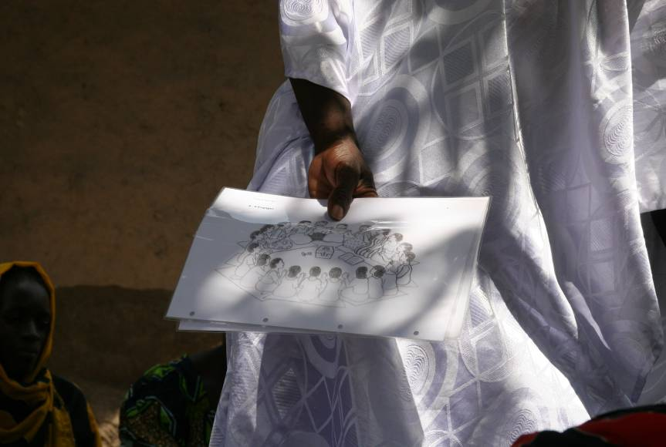

Slide 22
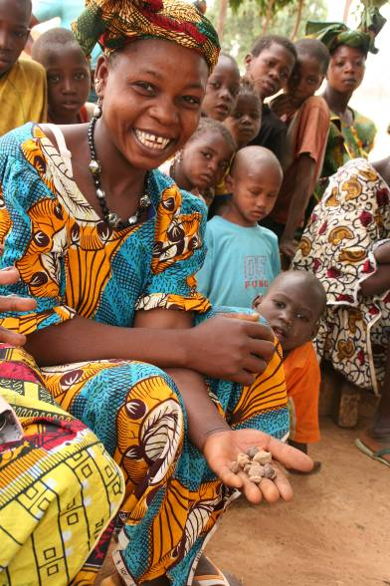

Slide 23
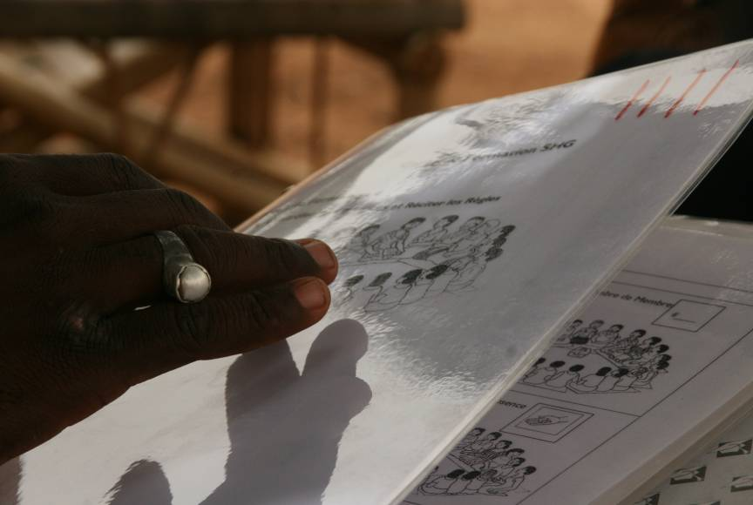

Slide 24
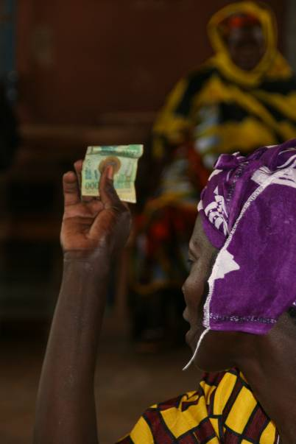

Slide 25
Member Satisfaction with SfC

Slide 26
What Members Value Most

Slide 27
Use of Loans: Mali

Slide 28
Malaria Prevention
Mortality high due to malaria
Distress sale of assets or loans at high interest rates to cover expenses
Decreased Livelihood and Income security

Slide 29
Prevention and Treatment

Slide 30
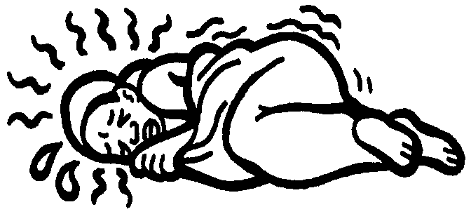
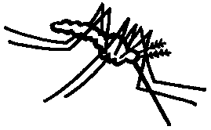
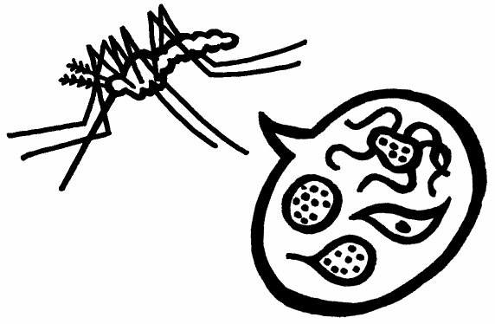

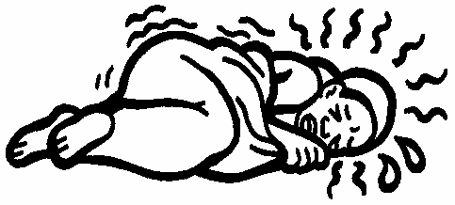
Transmission

Slide 31
Indications of Malaria
Vomits everything
Does not eat

Slide 32
Indications of Malaria
Convulsions
Lethargy

Slide 33
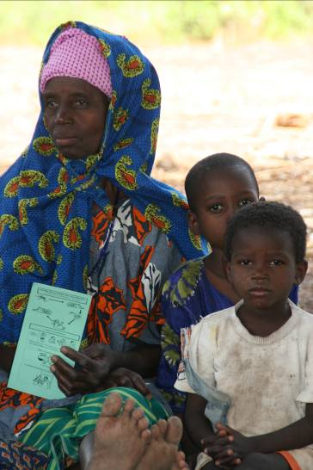
Malaria Training Works

Slide 34
Results
 | Participants | Non-participants
Mosquitoes cause malaria | 75% | 52%
Bed net best way to prevent malaria | 70% | 40%
Slept under bed net last night | 59% | 30%
Shared learning | 70% | 30%
Purchased bed net since joining SfC | 43% | NA

Slide 35
System of Rice Intensification
80% population rural
80%+ engaged in rice production
Small landholdings
High use of pesticides and insecticides
Decreasing returns from land

Slide 36
System of Rice Intensification
Decreased water usage
Decreased pesticide and insecticide use
Increased labor
Increased returns from rice cultivation (two to three times the average productivity)

Slide 37
System of Rice Intensification
Rice plants - Seedlings are transplanted:
very young -- usually just 8-12 days old, with just two small leaves
carefully and quickly to have minimum trauma to the roots
singly, only one per hill instead of 3-4 together to avoid root competition
widely spaced to encourage greater root and canopy growth
in a square grid pattern, 25x25 cm or wider -- 30x30 cm or 40x40 cm, even up to 50x50 cm with the best quality soil

Slide 38
Results

Slide 39
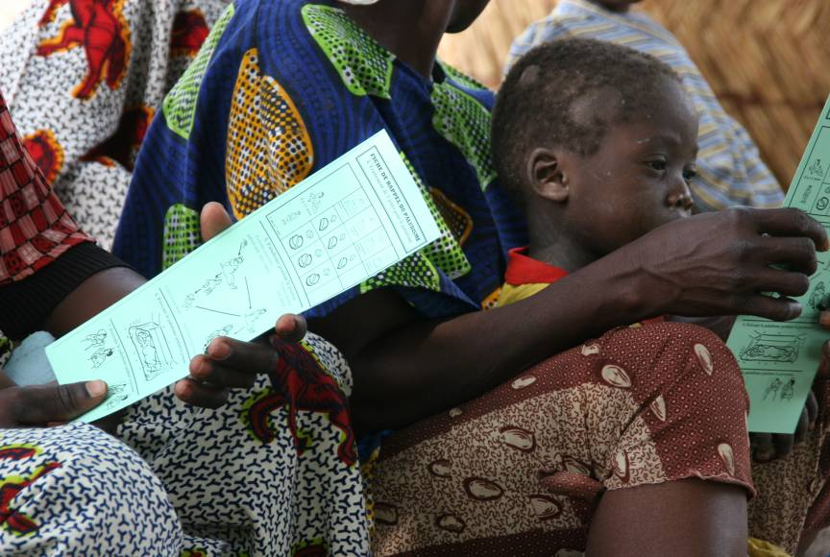

Slide 40
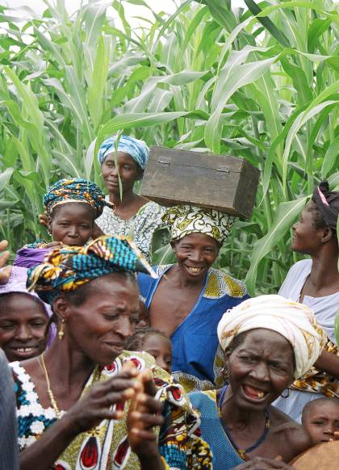
“Hope is in the box.”

Slide 41
Plans for Expansion
Expansion to 7 countries 1,000,000 members by 2015
Expand education package
Document and teach other institutions

Slide 42
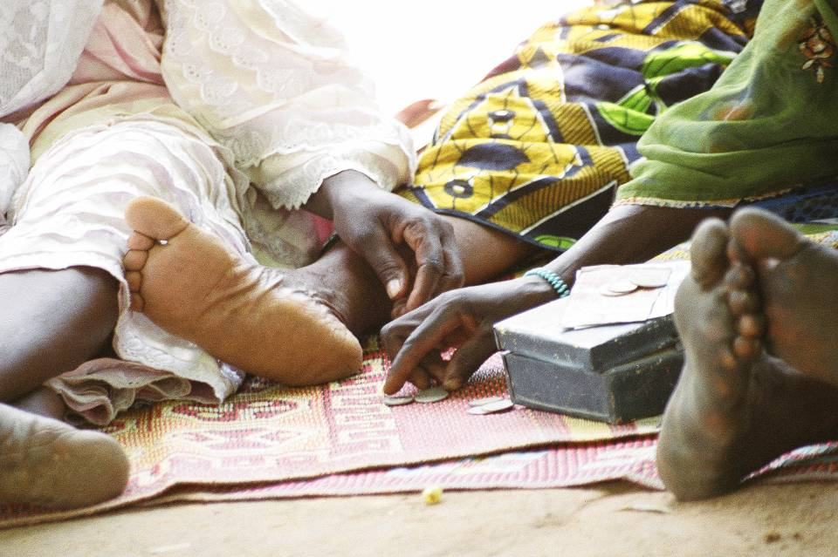
THANK YOU

